Slide 1


Dashboard Of : Medical Insurance Cost
SUDIPTA GIRI

Slide 2

Executive Summary:
This project aims to develop interactive and insightful dashboards using POWER BI for Medical Insurance Cost, to enhance data-driven decision-making. The dashboards will focus on key performance indicators, providing a visual representation of critical business metrics.
This project aims to assist the management team of a medical insurance company and insurance brokers by providing informative visualizations through Power BI. By exploring regional variations in total medical insurance costs and identifying cost disparities across different age groups, BMI categories, gender, and smoking status, the dashboard offers a comprehensive view of healthcare expenses.

Slide 3

PROBLEM Statement :
Background
Limited visibility into real-time performance metrics hinders timely decision-making.
Objective
Develop dashboards to monitor and analyze key performance indicators.
Scope
Initial focus on insurance, regional variations in total medical insurance costs and identifying cost disparities.
TARGET
Empower decision-making processes within the medical insurance company, enabling better healthcare management and customer service.

Slide 4

Data sources
Dataset Link: https://www.kaggle.com/datasets/mirichoi0218/insurance
Data examination
Data transformation
The dataset in this study contains both qualitative and quantitative data. The data size consists of 1338 rows and seven columns in one file. The dataset has no missing values and errors and is ready to analyze the result.
i) Check the missing values
ii) Age and BMI columns transform into categorical data types.

Slide 5

Methodology:
DATA ETL
Extract, Transform and load the data into POWER BI
DATA INTEGRATION
Integrate data from various sources into POWER BI.
DASHBOARD DESIGN
Collaborate with stakeholders to identify key metrics and design visually appealing dashboards.
INTERACTIVITY
Implement interactive features for drill-down analysis and trend exploration.
This Photo by Unknown Author is licensed under CC BY-SA

Slide 6

Expected Outcomes:
Interactivity
Interactive dashboard using the visualization tool POWER BI to help the executive and empower decision-making processes within the medical insurance company, enabling better healthcare management and customer service.
Decision making
Enhanced decision-making through visual representation of key metrics
Team synergy
Enhanced decision-making through visual representation of key metrics

Slide 7
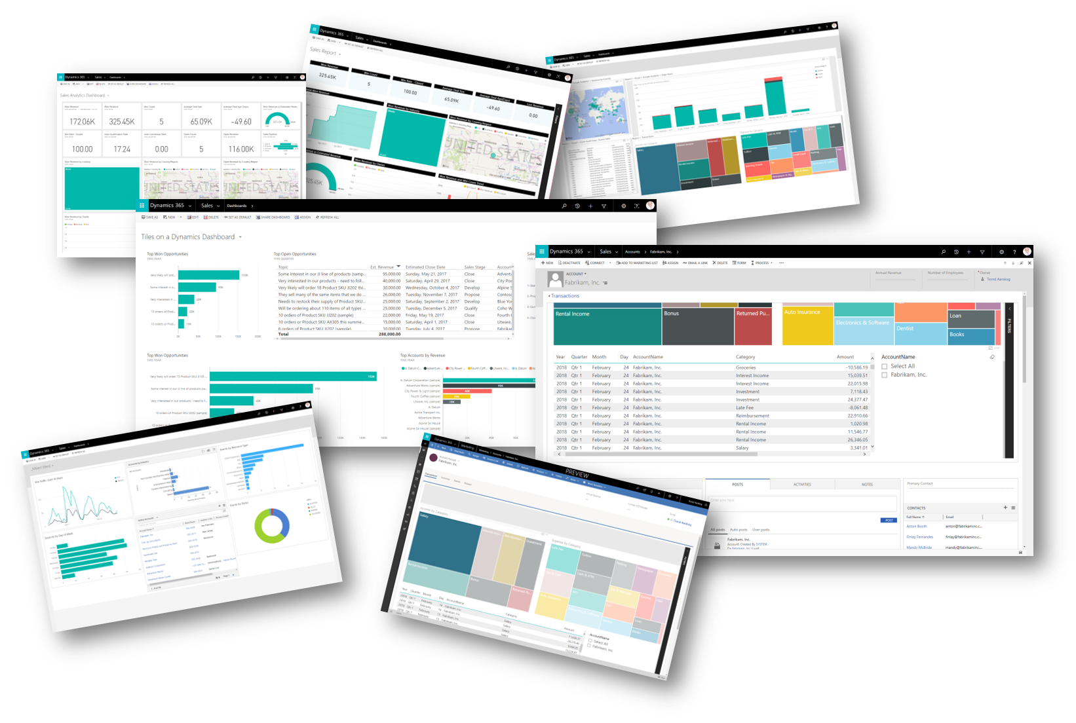



Tools and Technologies:
POWER BI
jupyter
Excel
POWER BI for dashboard development
For data clean up and feature selection
For documenting the data which will be loaded in other tools

Slide 8

Risks and Challenges:
integration
DATA
user
Integration challenges may arise while connecting to diverse data sources
Data size is big and may lag the computer
Ensuring data accuracy and consistency across dashboards.
This Photo by Unknown Author is licensed under CC BY

Slide 9

Conclusion:
This project is poised to empower Medical Insurance Cost. with visually engaging and informative dashboards, facilitating quicker and more informed decision-making. The dashboards will be tailored to the specific needs of the organization, ensuring a user-friendly experience that promotes data-driven decision culture.
This Photo by Unknown Author is licensed under CC BY-SA

Slide 10


THANK YOU
SUDIPTA GIRI
+91 7908144113
girisudiptowork@gmail.com

Slide 11


